Slide 1
Using Content-Based Filtering for Recommendation
Robin van Meteren and Maarten van Someren

Slide 2
- Motivation
- Methodology
- Results
- Conclusion

Slide 3
Motivation
Recommender systems can improve a website for individual users by dynamically adding hyperlinks.
In this paper the recommender system PRES (acronym for Personalized Recommender System) is introduced.
PRES creates dynamic hyperlinks for a website containing a collection of advice about do-it-yourself home improvement.
The purpose of these dynamic hyperlinks is to make it easier for a user to find interesting items and thus improving the interaction between the system and the user.

Slide 4
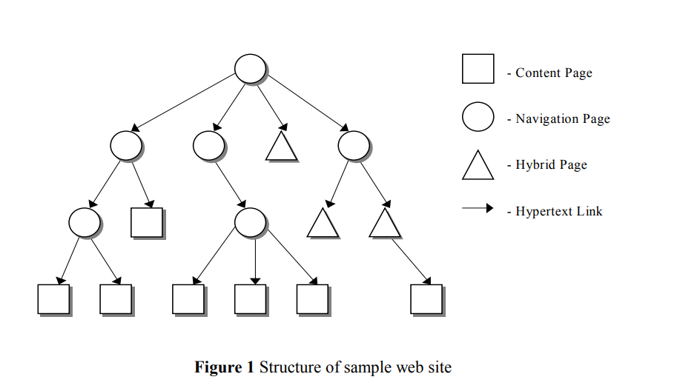
Every large collection needs a certain structure to make it easy for visitors to find what they are looking for.
The content pages provide the user with the interest items.
The navigation pages help the user to search for interest items.
A recommender system can display its recommendations by dynamically creating hypertext links to content pages that contain the items a user might be interested in.

Slide 5
Considerations for dynamic linking
There are several factors to determine the recommendation.
If content pages contain similar item(s) shown on the current page.
Proximity to the recommended page.
The further the distance, the more useful a dynamically created link becomes.

Slide 6
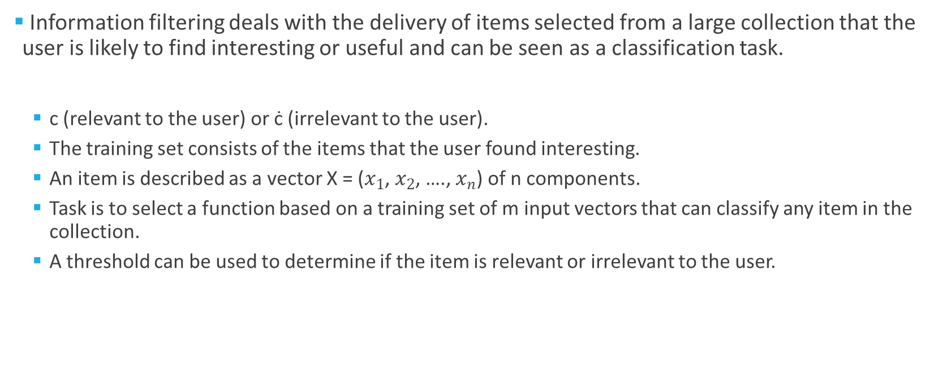
Content-based filtering
Information filtering deals with the delivery of items selected from a large collection that the user is likely to find interesting or useful and can be seen as a classification task.
c (relevant to the user) or ċ (irrelevant to the user).
The training set consists of the items that the user found interesting.
An item is described as a vector X = ($x_{1}$, $x_{2}$, …., $x_{n}$) of n components.
Task is to select a function based on a training set of m input vectors that can classify any item in the collection.
A threshold can be used to determine if the item is relevant or irrelevant to the user.

Slide 7
Content-based filtering
A content-based filtering system selects items based on the correlation between the content of the items and the user’s preferences.
PRES is a content-based filtering system.
Makes recommendations by comparing a user profile with the content of each document in the collection.
The content of a document can be represented with a set of terms extracted from documents.
Terms are extracted from documents by running through a number of parsing steps.
HTML tags and stop words are removed.
The remaining words are reduced to their stem by removing prefixes and suffixes.
“computer”, “computers” and “computing” could all be reduced to “comput”.

Slide 8

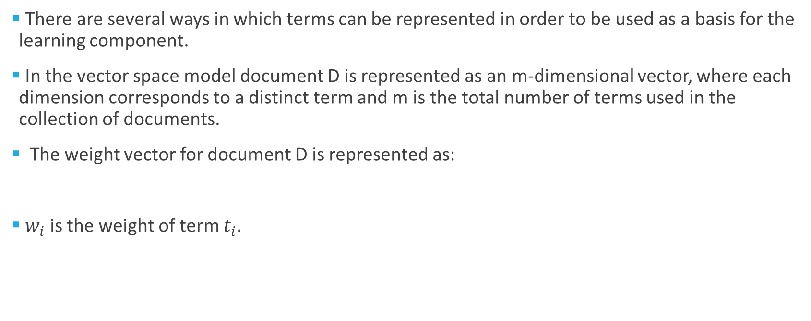
Content-based filtering
There are several ways in which terms can be represented in order to be used as a basis for the learning component.
In the vector space model document D is represented as an m-dimensional vector, where each dimension corresponds to a distinct term and m is the total number of terms used in the collection of documents.
The weight vector for document D is represented as:
$w_{i}$ is the weight of term $t_{i}.$

Slide 9
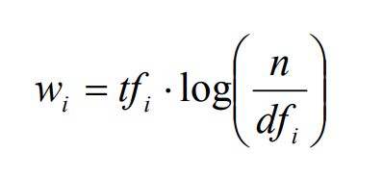
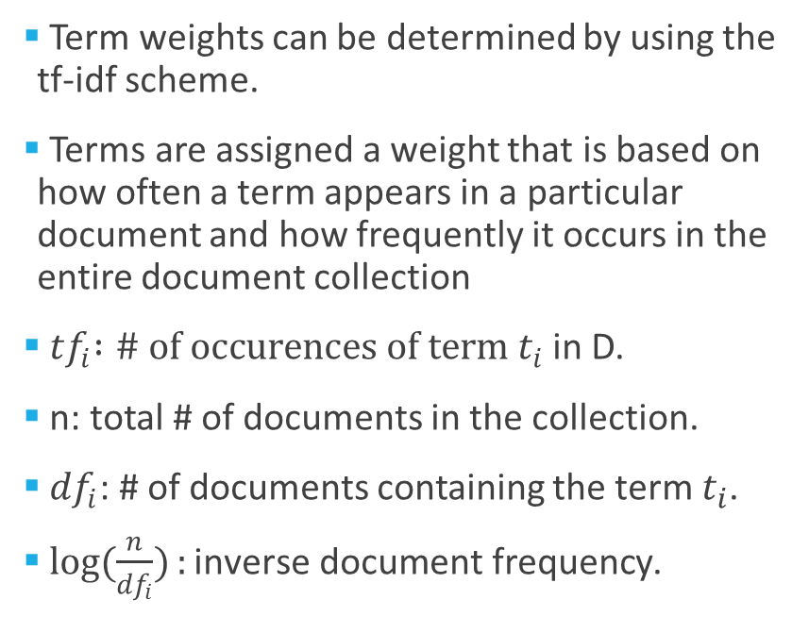
Term Frequency – Invert Document Frequency
Term weights can be determined by using the tf-idf scheme.
Terms are assigned a weight that is based on how often a term appears in a particular document and how frequently it occurs in the entire document collection
${ tf}_{i} :\# of occurences of term t_{i}$ in D.
n: total # of documents in the collection.
${df}_{i}$: # of documents containing the term $t_{i}$.
$\log{(\frac{n}{{df}_{i}})}:\text{inverse} \text{document} \text{frequency}$.

Slide 10
Term Frequency – Invert Document Frequency
The more times a term appears in a document, the more relevant it is to the topic of the document.
The more times a term occurs in all documents in the collection, the more poorly it discriminates between documents.

Slide 11

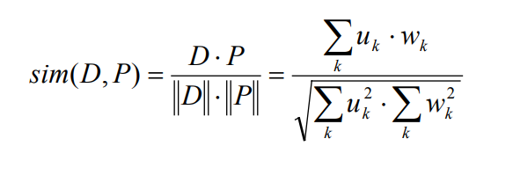

Cosine Similarity
Dot Product
Magnitude or norm
(Euclidean norm)

Slide 12
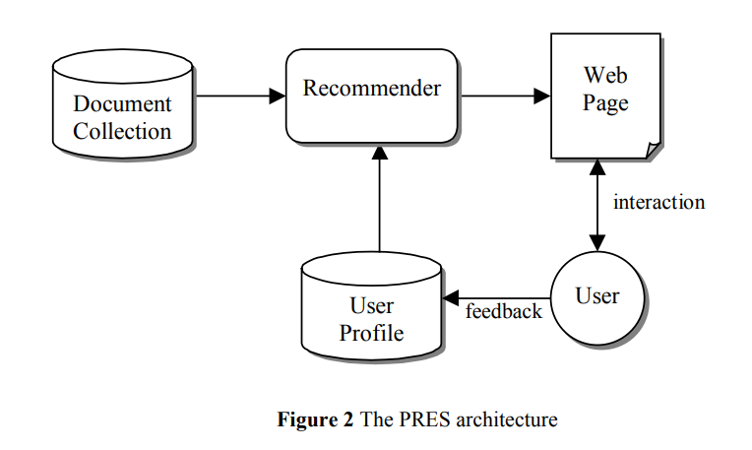
PRES

Slide 13
Domain Characteristics
PRES recommends documents that consist of textual information.
A certain topic is only interesting to a user for a short period of time.
The user model that PRES learns has to be very dynamic.
Explicit feedback is not a good choice.
Users will have to rate items frequently.
Only positive examples are used.
Finding negative examples is much more problematic.
Users ignoring links to documents could be seen as a clue.
A document that is being read for a very short time.

Slide 14
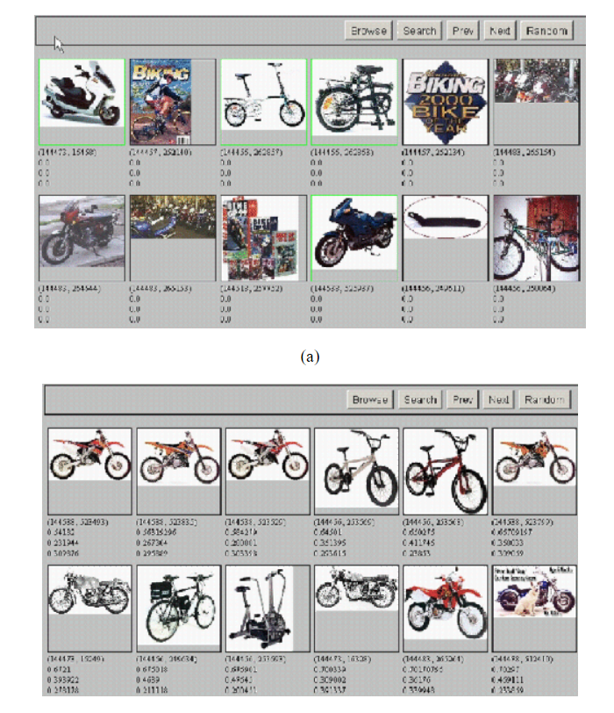
Learning Algorithm
PRES employs the relevance feedback method because it is both efficient and dynamic.
Involve the user!
The user issues a (short, simple) query.
The system returns an initial set of retrieval results.
The user marks some returned documents as relevant or nonrelevant.
The system computes a better representation of the information needed based on user feedback.
The system displays a revised set of retrieval results.
Image taken from Relevance feedback and pseudo relevance feedback (stanford.edu)

Slide 15
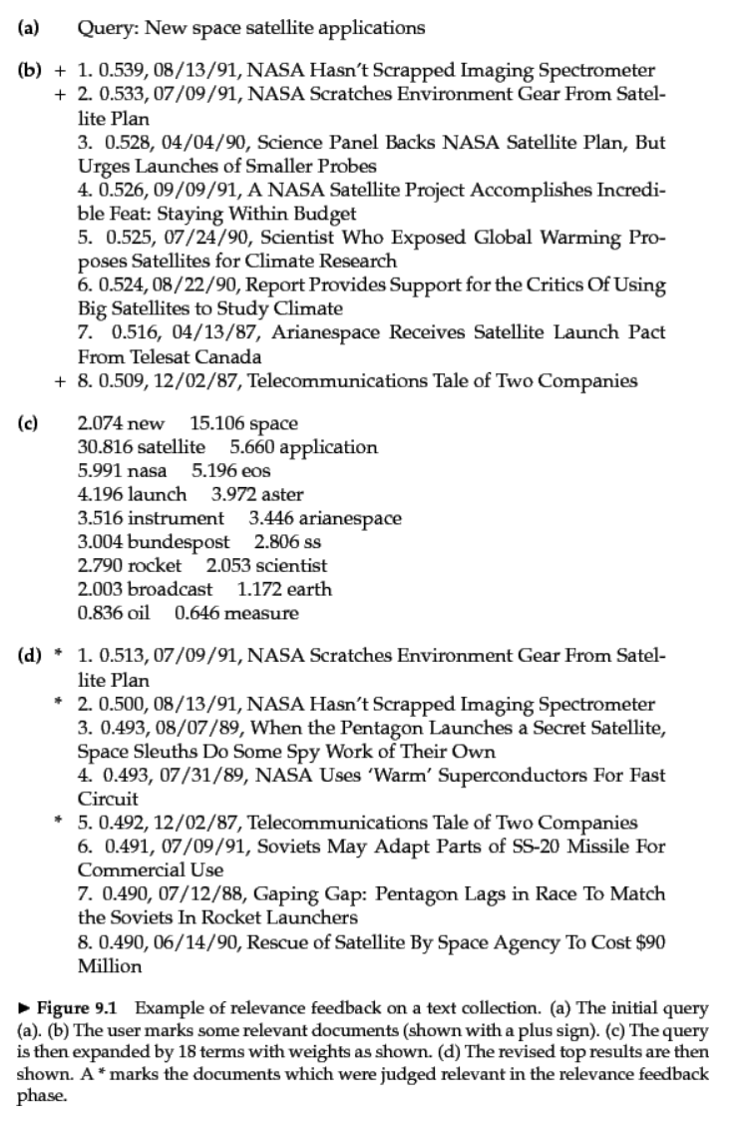
Image taken from Relevance feedback and pseudo relevance feedback (stanford.edu)

Slide 16

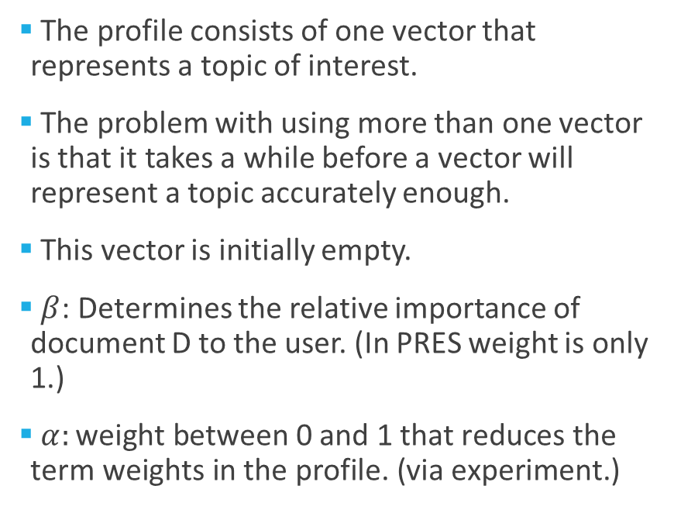
Learning Algorithm
The profile consists of one vector that represents a topic of interest.
The problem with using more than one vector is that it takes a while before a vector will represent a topic accurately enough.
This vector is initially empty.
$β$: Determines the relative importance of document D to the user. (In PRES weight is only 1.)
$α:\text{weight} \text{between}\text{ 0 }\text{and}\text{ 1 }\text{that} \text{reduces} \text{the} \text{term} \text{weights} \text{in} \text{the} \text{profile}\text{. (}\text{via} \text{experiment}\text{.)}$

Slide 17
Learning Algorithm
The similarity between a document vector and the profile vector can be calculated using several similarity measurements.
The novelty of a document is determined by the existence of information in a document that is new to the user.
The proximity of a document is determined by the minimal number of links it takes to navigate from the current page to a page that presents the document.
Some recommender systems also check if a document is relevant to the information shown on the current page.

Slide 18
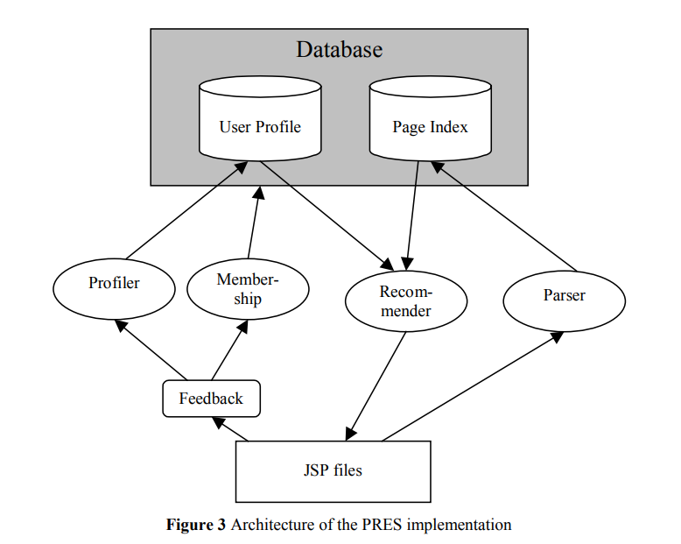
PRES Implementation
Profiler: Keeps track of the visited pages.
Membership: Enables the user to become a member.
Parser:
Analyses web pages.
Extracts terms.
Calculates tf-idf.

Slide 19
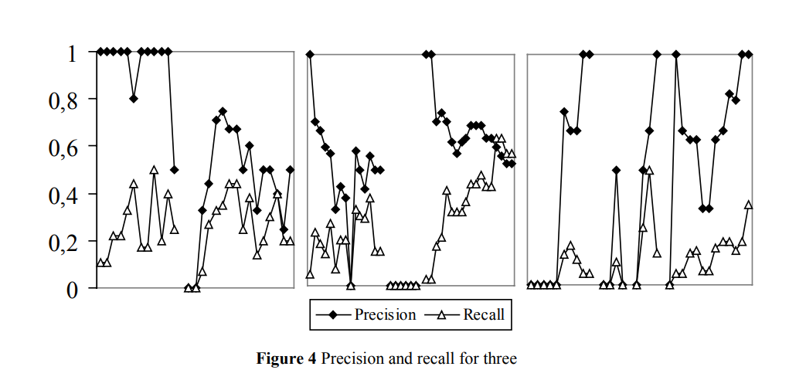
Evaluation
Three users were created.
Two topics about home improvement were assigned to the first user, three to the second user, and four to the third user.
For each topic all the relevant documents in the collection were selected and classified as relevant if it contained information that was associated with the topic.
The first user selected 80% of all the relevant documents about the two topics, the second user 50% and the third user 30%.
Precision (relevant retrieved/retrieved)
Recall (relevant retrieved/relevant)

Slide 20
Evaluation Results
The precision ratios differ significantly for different topics of interest.
Precision ratios also differ at different points in time for the same topics of interest.
As more documents about a certain topic are selected it becomes easier for a learning method to make recommendations as it is provided with more similar terms.
On the other hand, as more documents are selected the number of remaining documents that are relevant decreases.
Documents about several topics contain many different terms.
The exact effects however remain difficult to measure as other factors, such as a page change, also have an influence on these ratios.

Slide 21
Conclusion
The test results seem to indicate that on average, slightly more than one out of two of the suggestions that PRES makes is relevant.
The results are negatively influenced by the fact that the same concept can usually be described with several terms and many terms have more than one meaning.
Better results might be obtained by improving the vector space model.
Content-based filtering systems cannot make predictions about the future interests of users.
Collaborative filtering systems can make suggestions to a user that are outside the scope of previously selected items.
The effectiveness of PRES can therefore be further improved if content-based and collaborative filtering would be combined.
The menu structure also has a great influence on the effectiveness of PRES.
The better the website is organized, the harder it will be to make recommendations.

